Slide 1

Visión por Computador
Domingo Mery
Departamento de Ciencia de la Computación
Escuela de Ingeniería
Universidad Católica de Chile
Challenges

Slide 2
Fairness

Slide 3
Fairness in Face Recognition is the process of correcting and mitigating algorithmic bias (for example, bias of race and ethnicity, gender, age, etc.) from face recognition models.
Fairness

Slide 4
How good is an algorithm?
What is “good”...?

Slide 5
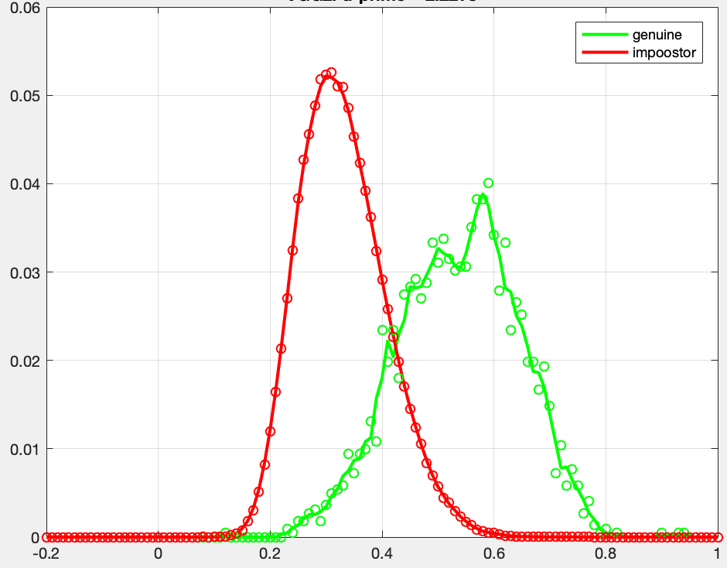
Some statistics
Distribution of d-
Probability density frequency
Distribution of d+
Area of each
distribution = 1
S
Performance:

Slide 6
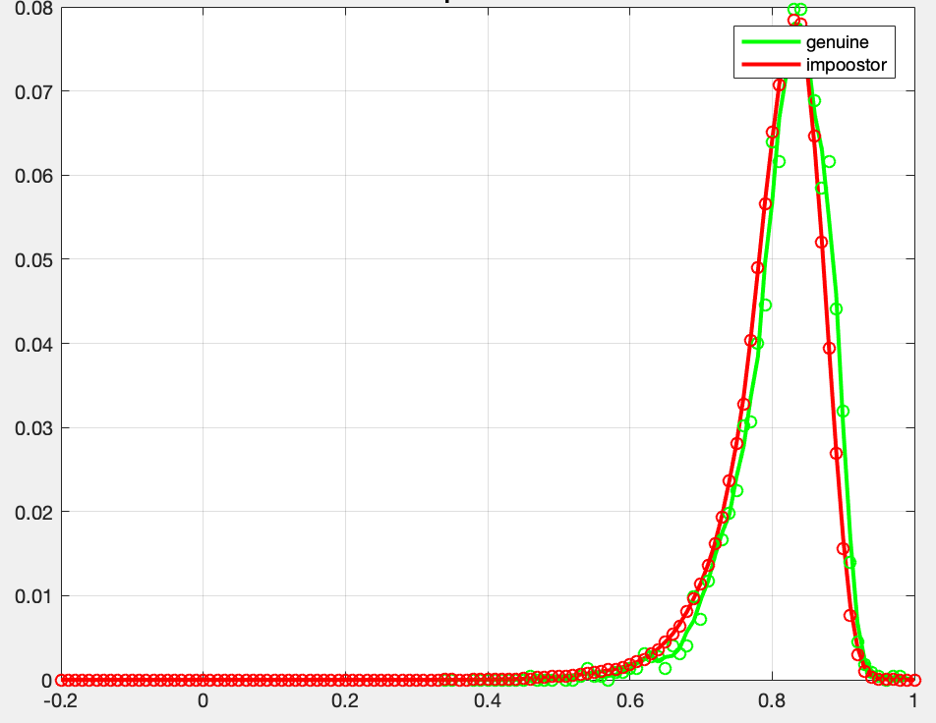
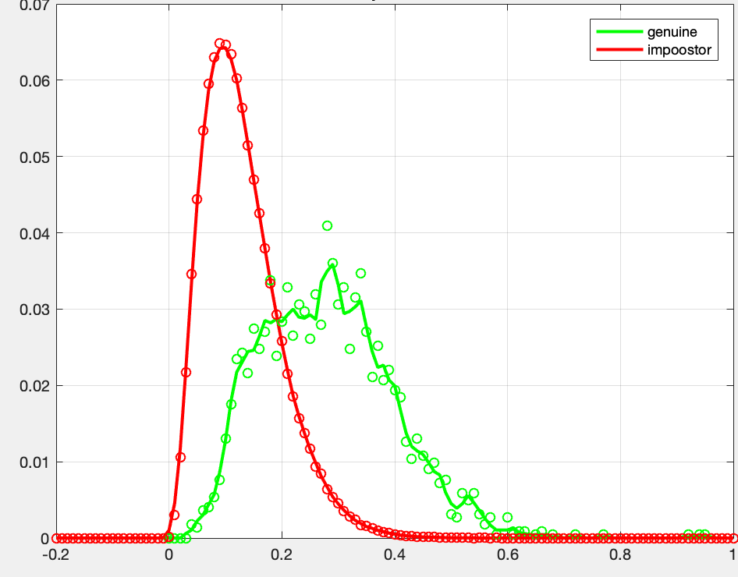
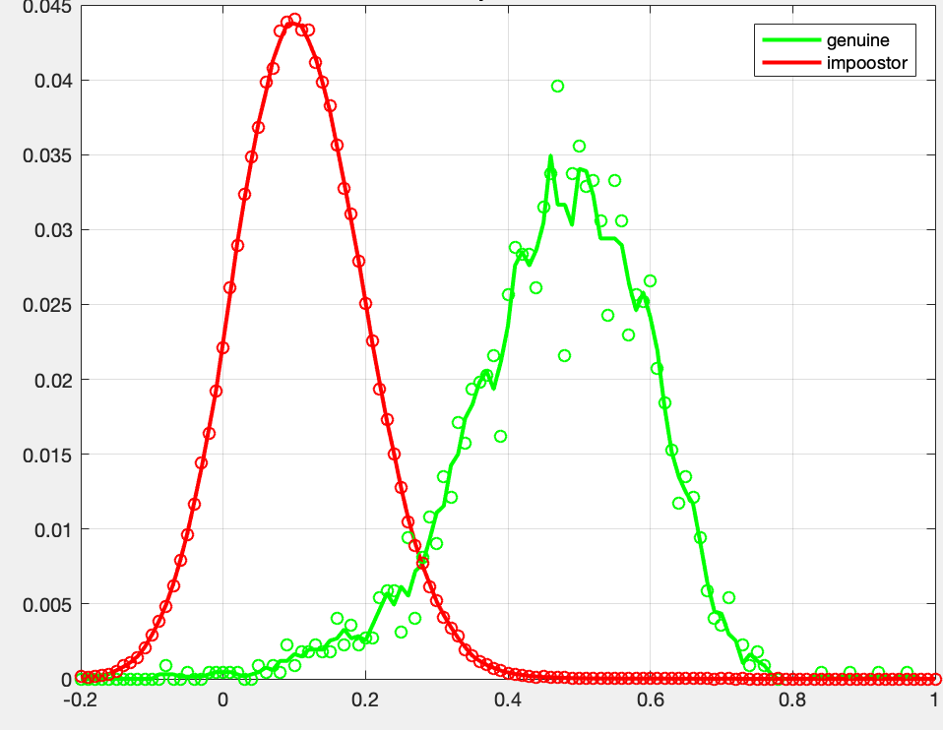
Some statistics
Examples of d’
for different algorithms
d’ = 0.20
d’ = 1.59
d’ = 2.22
d’ = 3.23
The best one

Slide 7

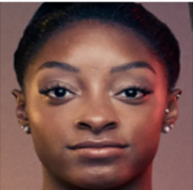
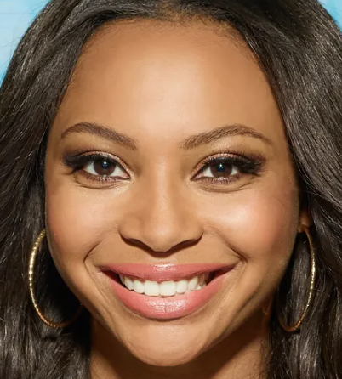
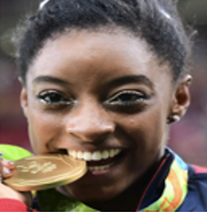
Some statistics
Probability density frequency
ERROR: FMR
ERROR: FNMR
S
Faces of different persons, but they were matched
Faces of the same person, but there is no match
FNMR
False Non-Match Rate
FMR
False Match Rate
threshold

Slide 8
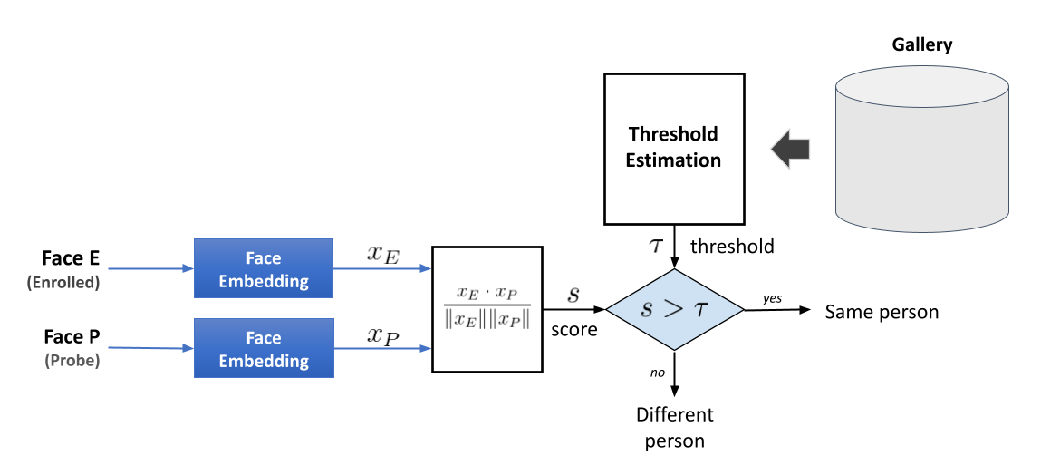


Face Verification using a Global Threshold
Standard Facial Verification Approach
sc

Slide 9
Is the performance of an algorithm the same for all demographic groups?
Unfortunately, it is not ...

Slide 10
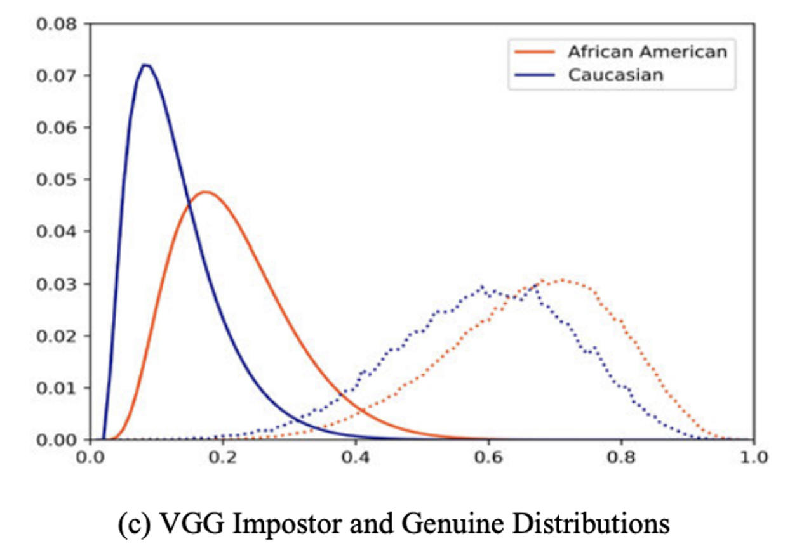
Genuine – Impostor Distribution for VGG
Global
Threshold

Slide 11
Genuine – Impostor Distribution for VGG
Introduction - Related Work - Proposed Methods - Methodology - Results - Conclusions
Threshold for
Caucasian
Total
Afro-American
Threshold for
Afro-American
Caucasian
Global
Threshold
Vangara, K., King, M. C., Albiero, V., & Bowyer, K. (2019). Characterizing the variability in face recognition accuracy relative to race. In Proceedings of the IEEE/CVF Conference on Computer Vision and Pattern Recognition Workshops

Slide 12
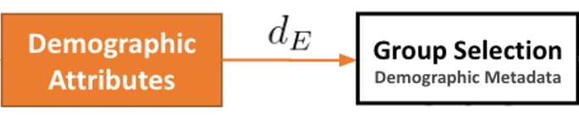
Face Verification using Demographic Thresholds
Standard Facial Verification Approach
sc

Slide 13

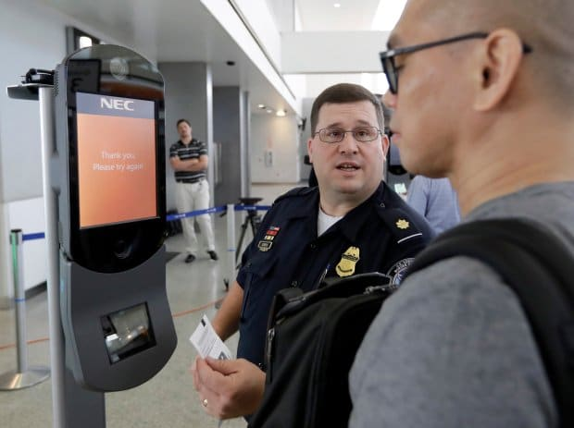

Should we use demographics in operational settings?
🤬
I’m Alaska Native
Introduction - Related Work - Proposed Methods - Methodology - Results - Conclusions
Excuse me, Sir, our algorithm says that you are an afro-american male...
Is it OK with you?
How to define a Demographic Group?
How specific should the group be?
only gender? or gender+race+age?
How many “races” should be defined?
Do we use an exhaustive list?
I’m non-binary
How to deal with sensitive information?
Both requesting and predicting demographic groups can be deemed controversial for facial recognition
(c) Esteban Villalobos
Image retrieved from: https://www.biometricupdate.com/202007/u-s-homeland-security-biometrics-leaders-discuss-public-engagement-privacy-and-legislation
Notes:
Explicar con situación

Slide 14
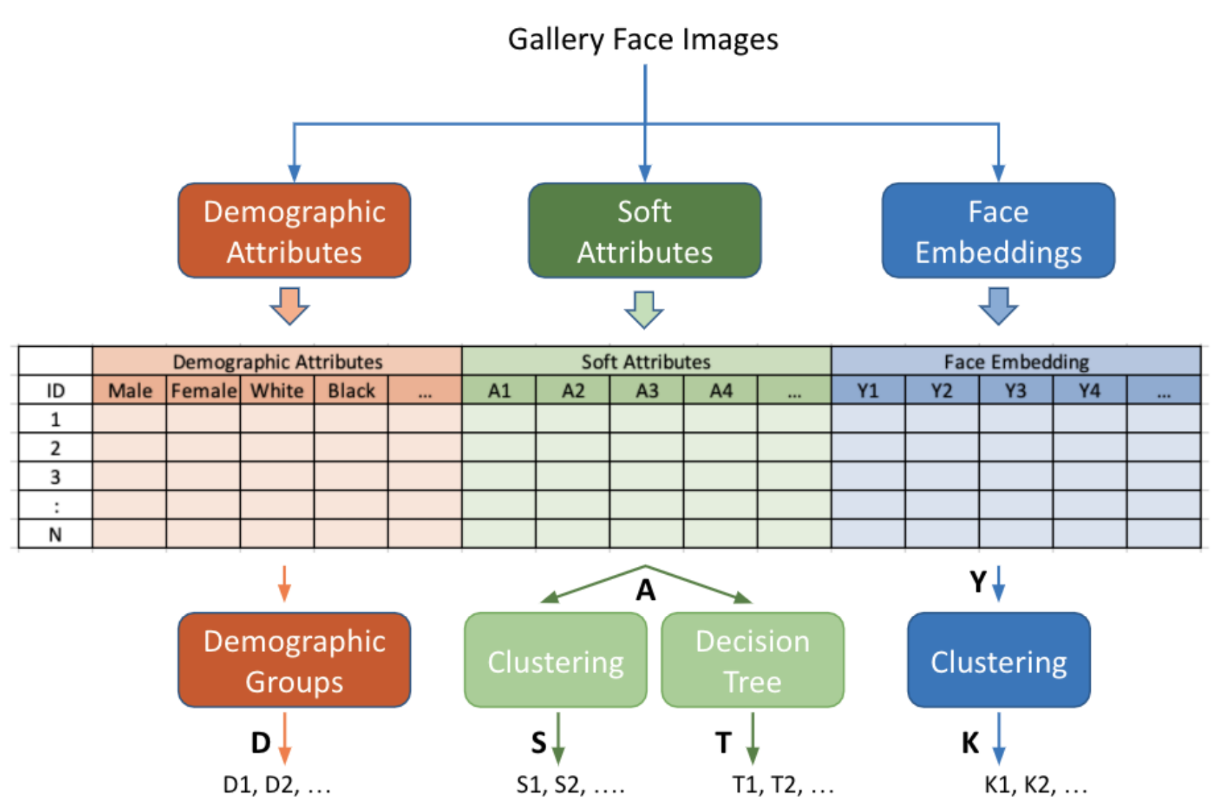

Slide 15

Face Verification using Soft Thresholds
Standard Facial Verification Approach
sc

Slide 16
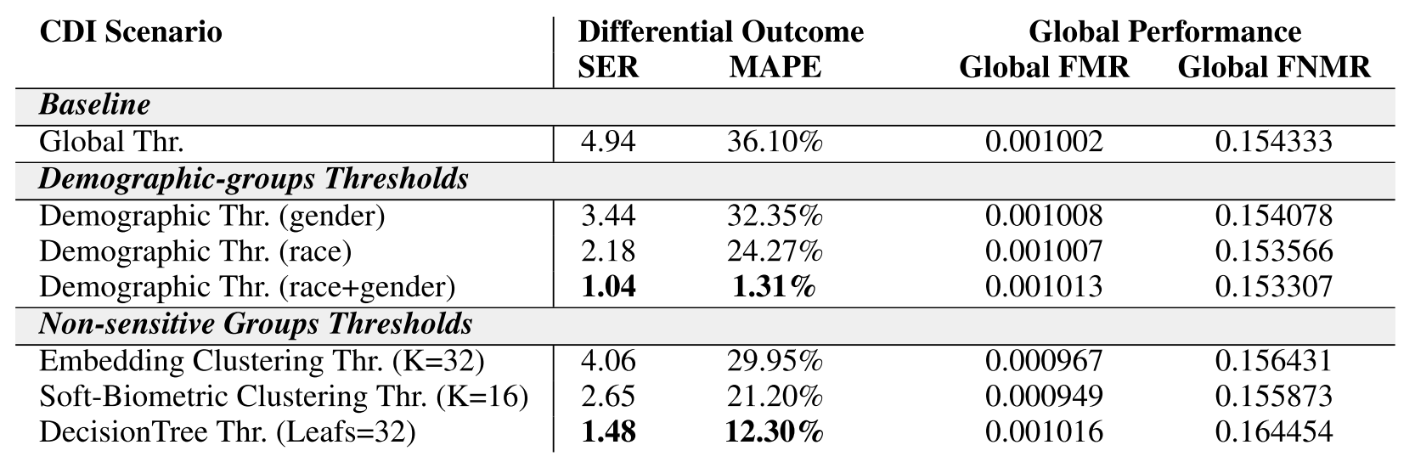
Villalobos E, Mery D, Bowyer K. Fair Face Verification by Using Non-Sensitive Soft-Biometric Attributes. IEEE Access. 2022 Mar 11;10:30168-79.

Slide 17
Low-Quality Face Recognition

Slide 18
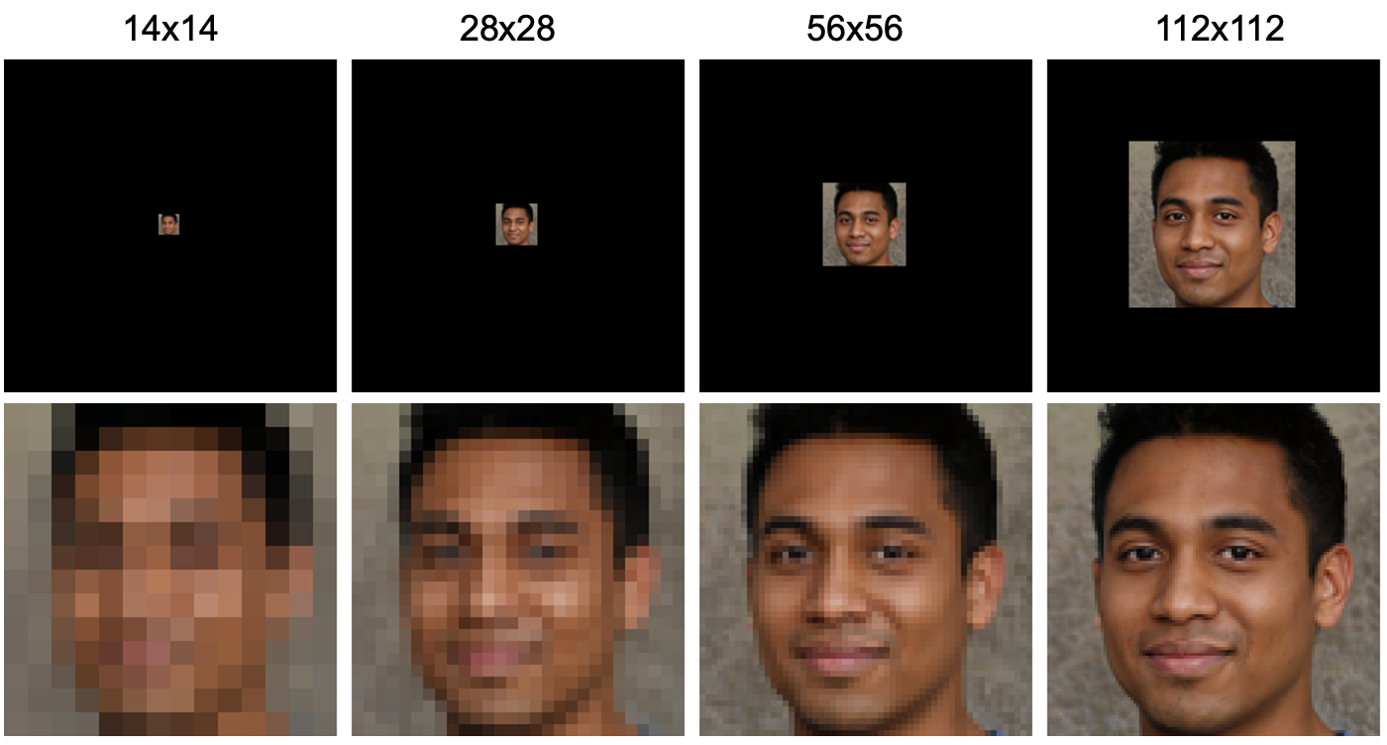
Example of low-resolution face images

Slide 19
Standard face verification approach
HR
sc

Slide 20

Low-resolution face verification approach
HR
HR
112 x 112
2
LR
14x14
28x28
56x56
SR
112 x 112
sc
Prieto, L., Pulgar, S., Flynn, P., & Mery, D. (2022, November). On Low-Resolution Face Re-identification with High-Resolution-Mapping. In Pacific-Rim Symposium on Image and Video Technology (PSIVT2022). (pp. 89-102). Cham: Springer International Publishing.
SR
UPSCALE
2
1

Slide 21
Experiments
2
Type | # | Name | Up-Scaling | Feature Extraction
Baseline | 1 | Bi-Arc | Bicubic interpolation | ArcFace
Simple | 2 | Bi-Face | Bicubic interpolation | FaceNet
TGAN | 3 | TGAN-Arc | Trained GAN | ArcFace
 | 4 | TGAN-GSia | Trained GAN | GAN trained siamese
Interpol+GTS | 5 | Area-GTS | Re-sampling using pixel area relation | GAN trained siamese
 | 6 | Bi-GTS | Bicubic interpolation | GAN trained siamese
 | 7 | Lanc-GTS | Lanczos interpolation over 8x8 pixels | GAN trained siamese
 | 8 | NN-GTS | Nearest neighbor interpolation | GAN trained siamese
Interpol+TS | 9 | Area-TS | Re-sampling using pixel area relation | Area trained siamese
 | 10 | Bi-TS | Bicubic interpolation | Bicubic trained siamese
 | 11 | Lanc-TS | Lanczos interpolation over 8x8 pixels | Lanczos trained siamese
 | 12 | NN-TS | Nearest neighbor interpolation | Nearest trained siamese
GAN’s | 13 | ESRGAN-TSia | ESRGAN | GAN trained siamese
 | 14 | GPEN256-Arc | GPEN256 | ArcFace
 | 15 | GPEN512-Arc | GPEN512 | ArcFace
 | 16 | GFPGAN1-Arc | GFPGAN1 | ArcFace
 | 17 | GFPGAN2-Arc | GFPGAN2 | ArcFace
 | 18 | EGFPGAN2-Arc | EGFPGAN2 | ArcFace
1

Slide 22
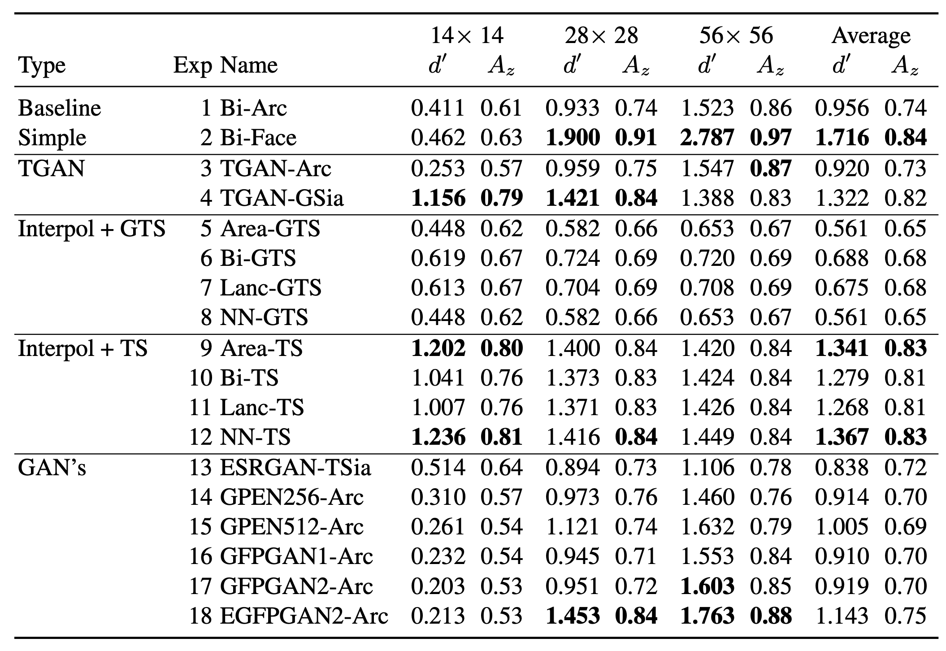
Experiments
Type | Exp | Name | Up-Scaling | Feature Extraction
Baseline | 1 | Bi-Arc | Bicubic interpolation | ArcFace
Simple | 2 | Bi-Face | Bicubic interpolation | FaceNet
TGAN | 3 | TGAN-Arc | Trained GAN | ArcFace
 | 4 | TGAN-GSia | Trained GAN | GAN trained siamese
Interpol+GTS | 5 | Area-GTS | Re-sampling using pixel area relation | GAN trained siamese
 | 6 | Bi-GTS | Bicubic interpolation | GAN trained siamese
 | 7 | Lanc-GTS | Lanczos interpolation over 8x8 pixels | GAN trained siamese
 | 8 | NN-GTS | Nearest neighbor interpolation | GAN trained siamese
Interpol+TS | 9 | Area-TS | Re-sampling using pixel area relation | Area trained siamese
 | 10 | Bi-TS | Bicubic interpolation | Bicubic trained siamese
 | 11 | Lanc-TS | Lanczos interpolation over 8x8 pixels | Lanczos trained siamese
 | 12 | NN-TS | Nearest neighbor interpolation | Nearest trained siamese
GAN’s | 13 | ESRGAN-TSia | ESRGAN | GAN trained siamese
 | 14 | GPEN256-Arc | GPEN256 | ArcFace
 | 15 | GPEN512-Arc | GPEN512 | ArcFace
 | 16 | GFPGAN1-Arc | GFPGAN1 | ArcFace
 | 17 | GFPGAN2-Arc | GFPGAN2 | ArcFace
 | 18 | EGFPGAN2-Arc | EGFPGAN2 | ArcFace

Slide 23
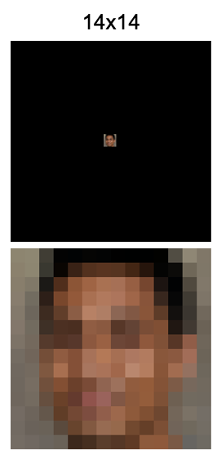
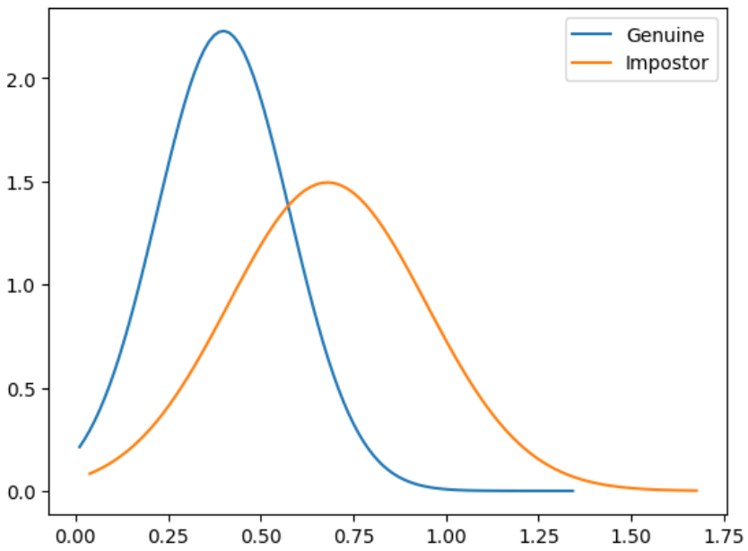
Experiments
Type | Exp | Name | Up-Scaling | Feature Extraction
Baseline | 1 | Bi-Arc | Bicubic interpolation | ArcFace
Simple | 2 | Bi-Face | Bicubic interpolation | FaceNet
TGAN | 3 | TGAN-Arc | Trained GAN | ArcFace
 | 4 | TGAN-GSia | Trained GAN | GAN trained siamese
Interpol+GTS | 5 | Area-GTS | Re-sampling using pixel area relation | GAN trained siamese
 | 6 | Bi-GTS | Bicubic interpolation | GAN trained siamese
 | 7 | Lanc-GTS | Lanczos interpolation over 8x8 pixels | GAN trained siamese
 | 8 | NN-GTS | Nearest neighbor interpolation | GAN trained siamese
Interpol+TS | 9 | Area-TS | Re-sampling using pixel area relation | Area trained siamese
 | 10 | Bi-TS | Bicubic interpolation | Bicubic trained siamese
 | 11 | Lanc-TS | Lanczos interpolation over 8x8 pixels | Lanczos trained siamese
 | 12 | NN-TS | Nearest neighbor interpolation | Nearest trained siamese
GAN’s | 13 | ESRGAN-TSia | ESRGAN | GAN trained siamese
 | 14 | GPEN256-Arc | GPEN256 | ArcFace
 | 15 | GPEN512-Arc | GPEN512 | ArcFace
 | 16 | GFPGAN1-Arc | GFPGAN1 | ArcFace
 | 17 | GFPGAN2-Arc | GFPGAN2 | ArcFace
 | 18 | EGFPGAN2-Arc | EGFPGAN2 | ArcFace

Slide 24
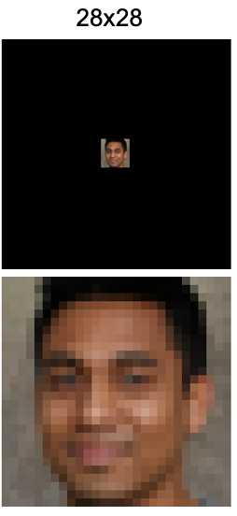
Experiments
Type | Exp | Name | Up-Scaling | Feature Extraction
Baseline | 1 | Bi-Arc | Bicubic interpolation | ArcFace
Simple | 2 | Bi-Face | Bicubic interpolation | FaceNet
TGAN | 3 | TGAN-Arc | Trained GAN | ArcFace
 | 4 | TGAN-GSia | Trained GAN | GAN trained siamese
Interpol+GTS | 5 | Area-GTS | Re-sampling using pixel area relation | GAN trained siamese
 | 6 | Bi-GTS | Bicubic interpolation | GAN trained siamese
 | 7 | Lanc-GTS | Lanczos interpolation over 8x8 pixels | GAN trained siamese
 | 8 | NN-GTS | Nearest neighbor interpolation | GAN trained siamese
Interpol+TS | 9 | Area-TS | Re-sampling using pixel area relation | Area trained siamese
 | 10 | Bi-TS | Bicubic interpolation | Bicubic trained siamese
 | 11 | Lanc-TS | Lanczos interpolation over 8x8 pixels | Lanczos trained siamese
 | 12 | NN-TS | Nearest neighbor interpolation | Nearest trained siamese
GAN’s | 13 | ESRGAN-TSia | ESRGAN | GAN trained siamese
 | 14 | GPEN256-Arc | GPEN256 | ArcFace
 | 15 | GPEN512-Arc | GPEN512 | ArcFace
 | 16 | GFPGAN1-Arc | GFPGAN1 | ArcFace
 | 17 | GFPGAN2-Arc | GFPGAN2 | ArcFace
 | 18 | EGFPGAN2-Arc | EGFPGAN2 | ArcFace

Slide 25
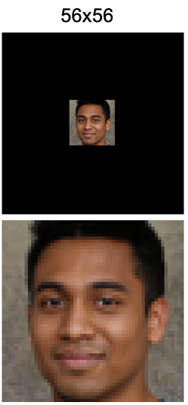
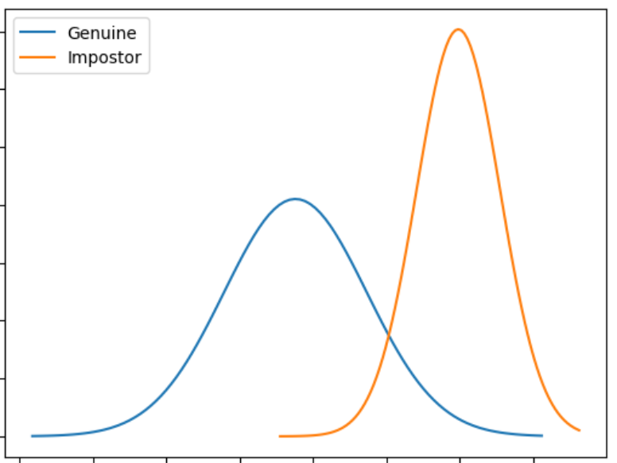
Experiments
Type | Exp | Name | Up-Scaling | Feature Extraction
Baseline | 1 | Bi-Arc | Bicubic interpolation | ArcFace
Simple | 2 | Bi-Face | Bicubic interpolation | FaceNet
TGAN | 3 | TGAN-Arc | Trained GAN | ArcFace
 | 4 | TGAN-GSia | Trained GAN | GAN trained siamese
Interpol+GTS | 5 | Area-GTS | Re-sampling using pixel area relation | GAN trained siamese
 | 6 | Bi-GTS | Bicubic interpolation | GAN trained siamese
 | 7 | Lanc-GTS | Lanczos interpolation over 8x8 pixels | GAN trained siamese
 | 8 | NN-GTS | Nearest neighbor interpolation | GAN trained siamese
Interpol+TS | 9 | Area-TS | Re-sampling using pixel area relation | Area trained siamese
 | 10 | Bi-TS | Bicubic interpolation | Bicubic trained siamese
 | 11 | Lanc-TS | Lanczos interpolation over 8x8 pixels | Lanczos trained siamese
 | 12 | NN-TS | Nearest neighbor interpolation | Nearest trained siamese
GAN’s | 13 | ESRGAN-TSia | ESRGAN | GAN trained siamese
 | 14 | GPEN256-Arc | GPEN256 | ArcFace
 | 15 | GPEN512-Arc | GPEN512 | ArcFace
 | 16 | GFPGAN1-Arc | GFPGAN1 | ArcFace
 | 17 | GFPGAN2-Arc | GFPGAN2 | ArcFace
 | 18 | EGFPGAN2-Arc | EGFPGAN2 | ArcFace

Slide 26
Experiments
Type | Exp | Name | Up-Scaling | Feature Extraction
Baseline | 1 | Bi-Arc | Bicubic interpolation | ArcFace
Simple | 2 | Bi-Face | Bicubic interpolation | FaceNet
TGAN | 3 | TGAN-Arc | Trained GAN | ArcFace
 | 4 | TGAN-GSia | Trained GAN | GAN trained siamese
Interpol+GTS | 5 | Area-GTS | Re-sampling using pixel area relation | GAN trained siamese
 | 6 | Bi-GTS | Bicubic interpolation | GAN trained siamese
 | 7 | Lanc-GTS | Lanczos interpolation over 8x8 pixels | GAN trained siamese
 | 8 | NN-GTS | Nearest neighbor interpolation | GAN trained siamese
Interpol+TS | 9 | Area-TS | Re-sampling using pixel area relation | Area trained siamese
 | 10 | Bi-TS | Bicubic interpolation | Bicubic trained siamese
 | 11 | Lanc-TS | Lanczos interpolation over 8x8 pixels | Lanczos trained siamese
 | 12 | NN-TS | Nearest neighbor interpolation | Nearest trained siamese
GAN’s | 13 | ESRGAN-TSia | ESRGAN | GAN trained siamese
 | 14 | GPEN256-Arc | GPEN256 | ArcFace
 | 15 | GPEN512-Arc | GPEN512 | ArcFace
 | 16 | GFPGAN1-Arc | GFPGAN1 | ArcFace
 | 17 | GFPGAN2-Arc | GFPGAN2 | ArcFace
 | 18 | EGFPGAN2-Arc | EGFPGAN2 | ArcFace

Slide 27
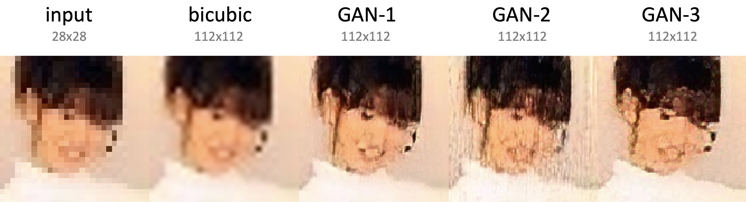
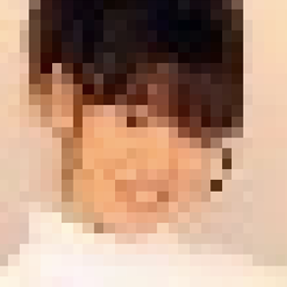
Super-resolution
examples 28x28

Slide 28
Super-resolution
examples 28x28

Slide 29
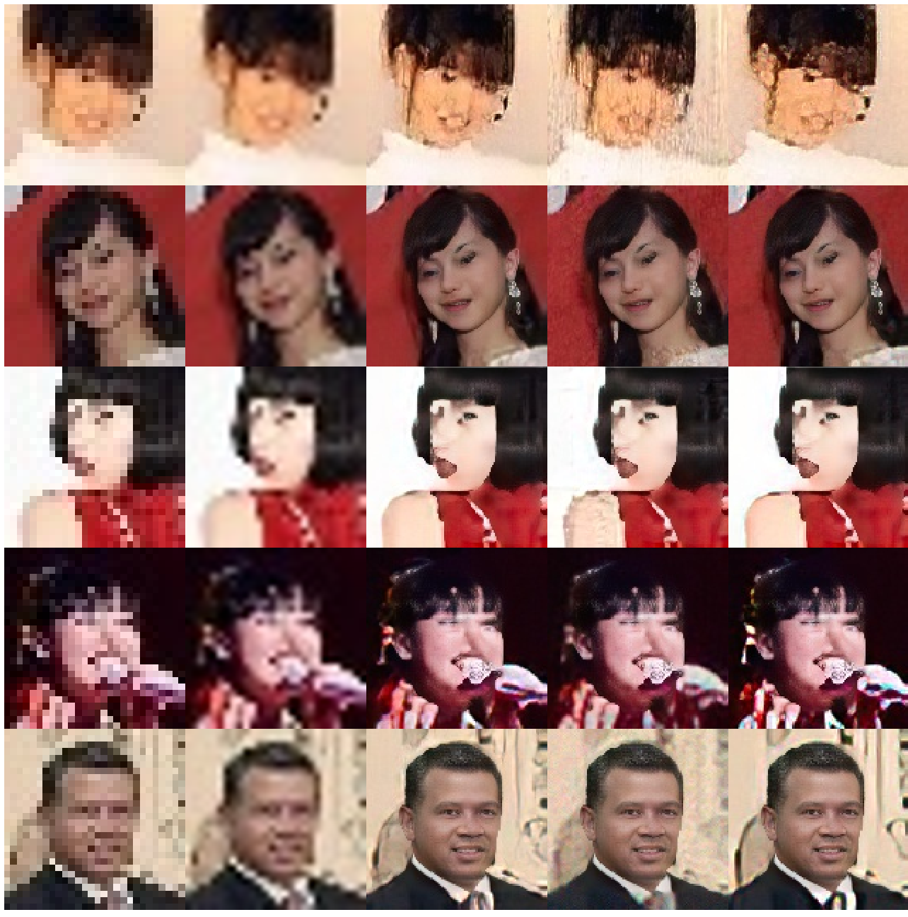
Super-resolution
examples 28x28

Slide 30
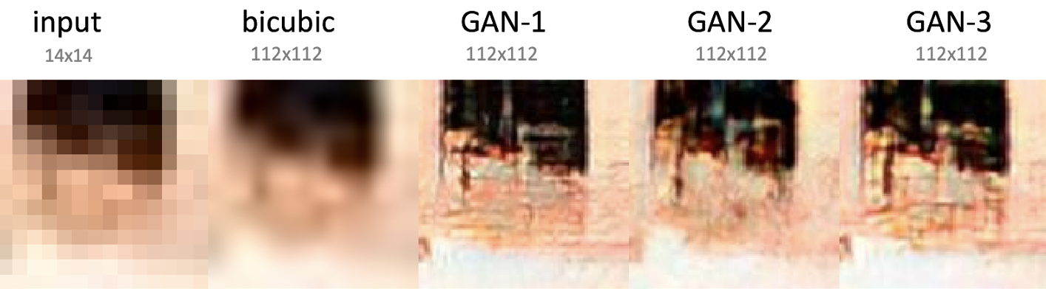

Super-resolution
examples 14x14

Slide 31
Super-resolution
examples 14x14

Slide 32
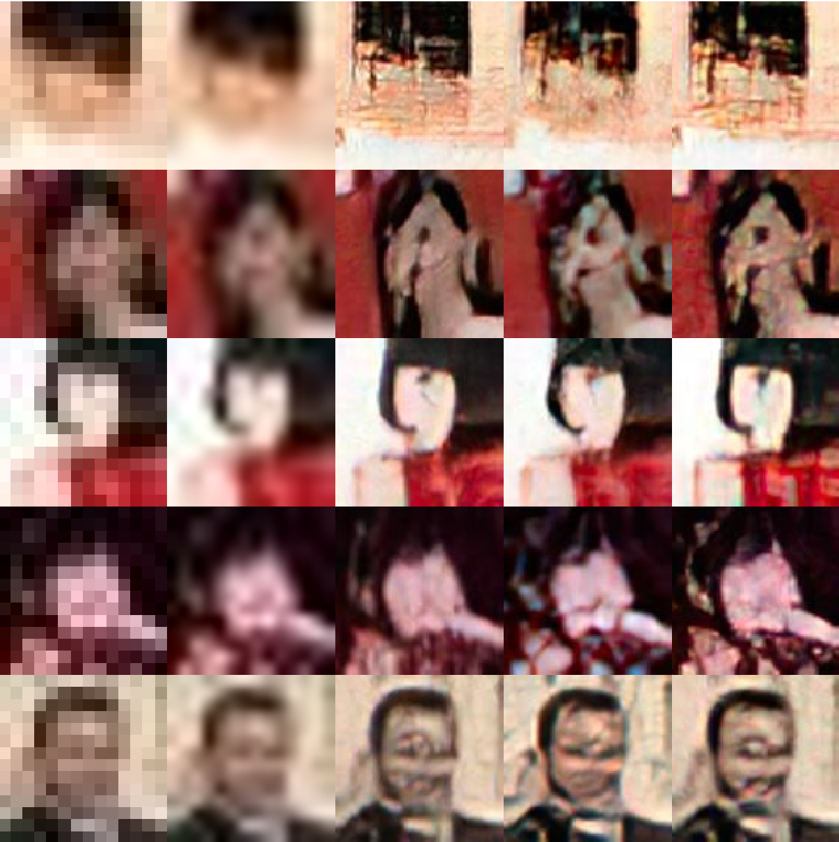
Super-resolution
examples 14x14

Slide 33
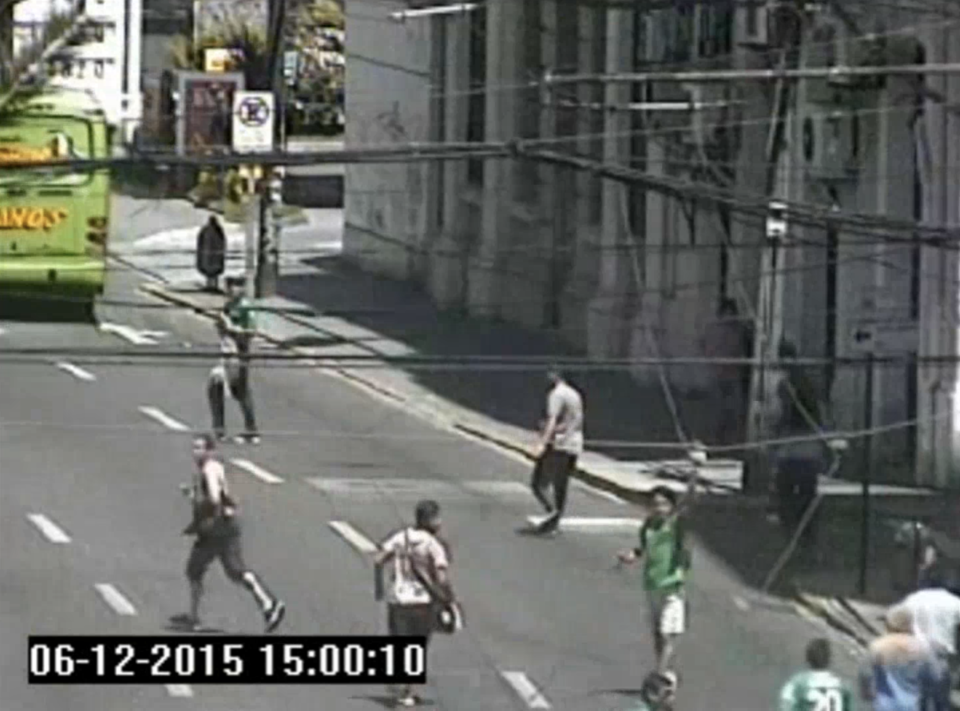
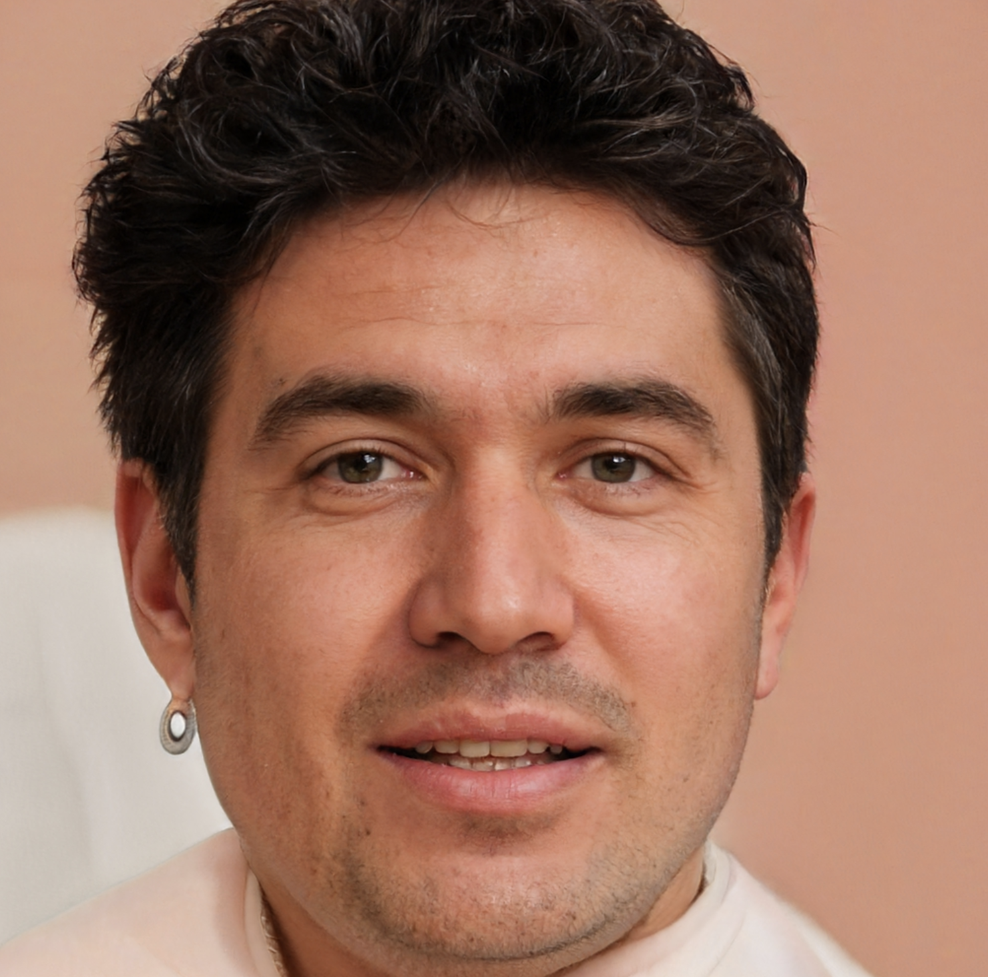

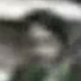
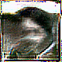
1. Who is this person?
2. Is the same person?
We don’t know. . .

Slide 34
Explainability

Slide 35
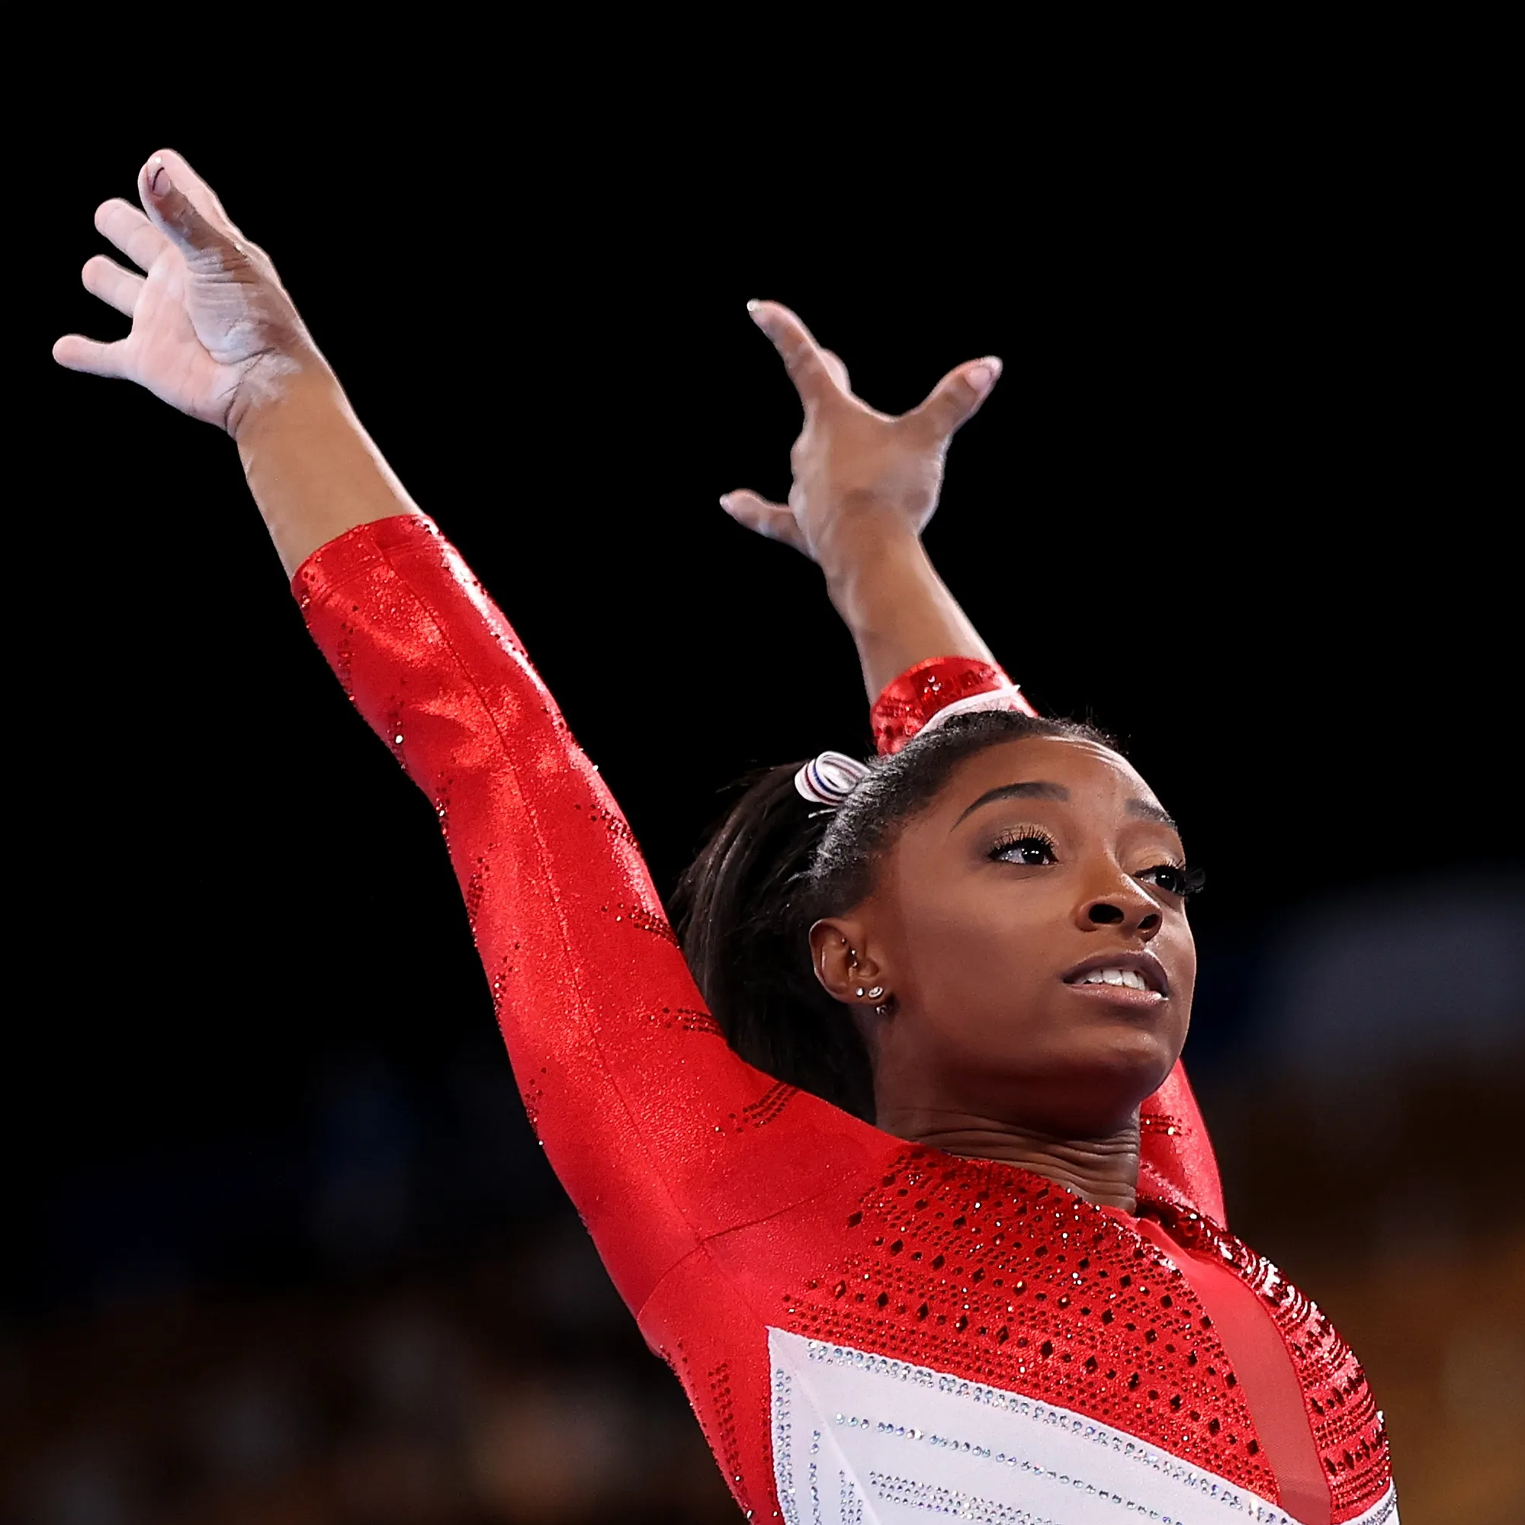
Explainability
f_{x}
Output
input
image
BLACK-BOX
Mery, D. (2022). True black-box explanation in facial analysis. In Proceedings of the IEEE/CVF Conference on Computer Vision and Pattern Recognition (pp. 1596-1605).

Slide 36
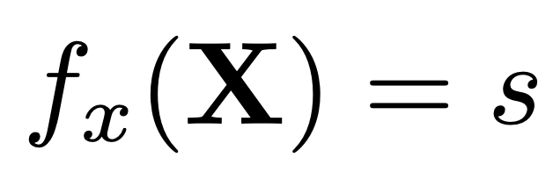
Explainability
BLACK-BOX
(model)
IMAGE
(input)
SCORE
(output)
f_{x}
X
s

Slide 37
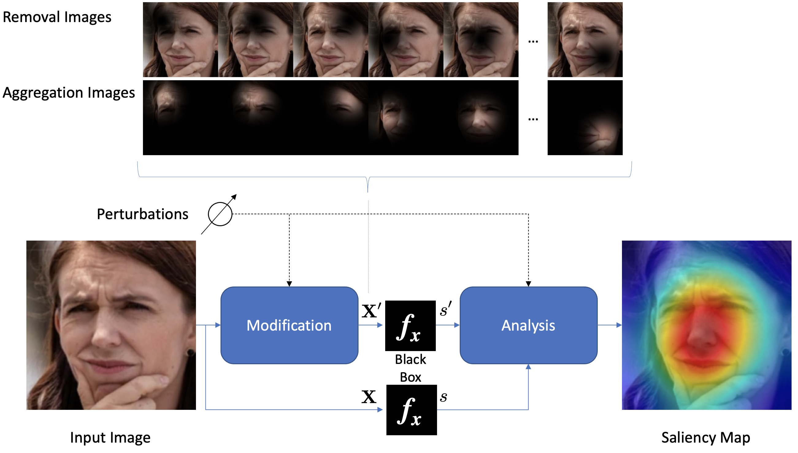
Key idea of the proposed method

Slide 39
Minus
MinPlus
Plus

Slide 40
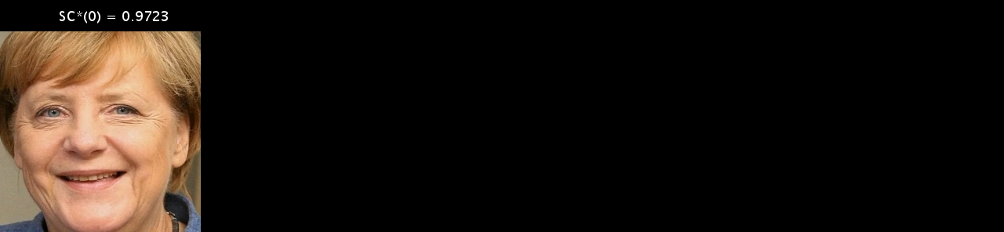
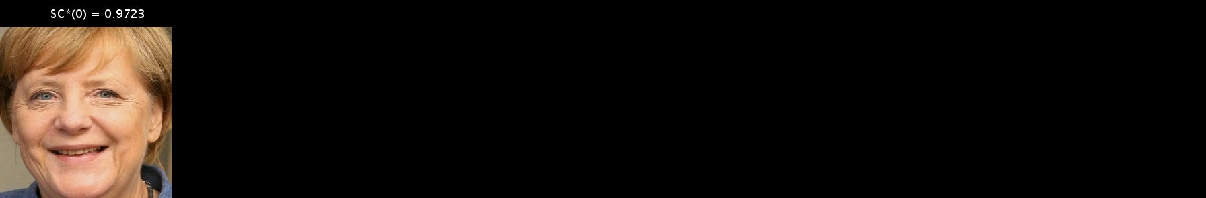
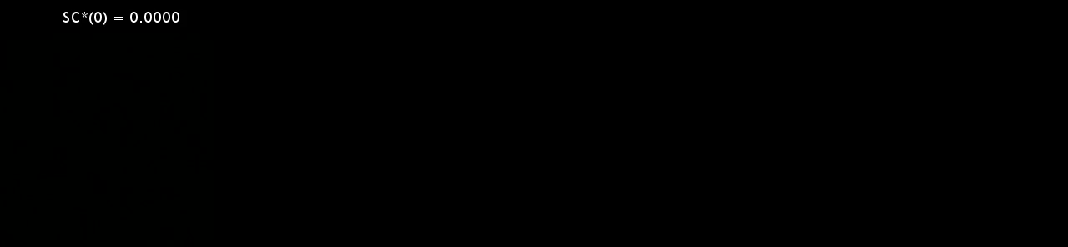
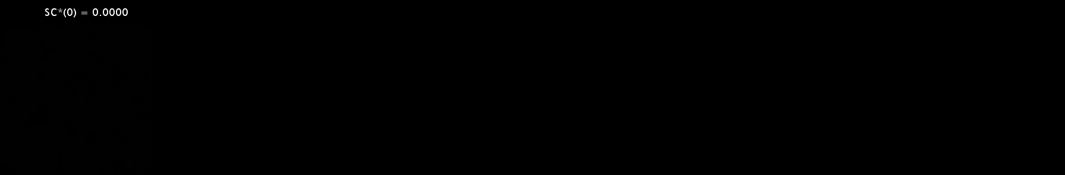

Slide 41
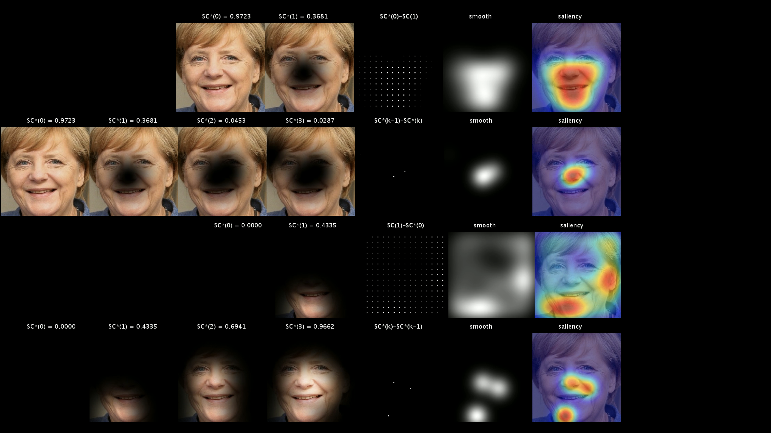
H₀–
H₁–
H₀+
H₁+

Slide 42
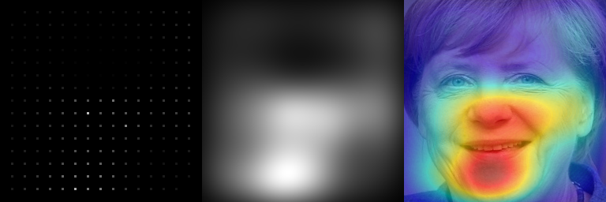
H₀–
H₁–
mean
H₀+
H₁+

Slide 43
H₀–
H₁–
mean smooth
H₀+
H₁+

Slide 44
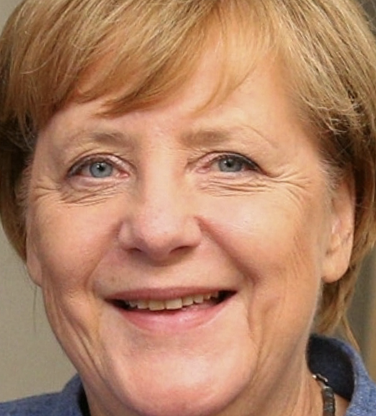
H₀–
H₁–
mean smooth saliency
H₀+
MinPlus
H₁+

Slide 45
Explanation: Relevant parts of the model for happiness
MinPlus
H₀–
H₀+
H₁–
H₁+

Slide 46
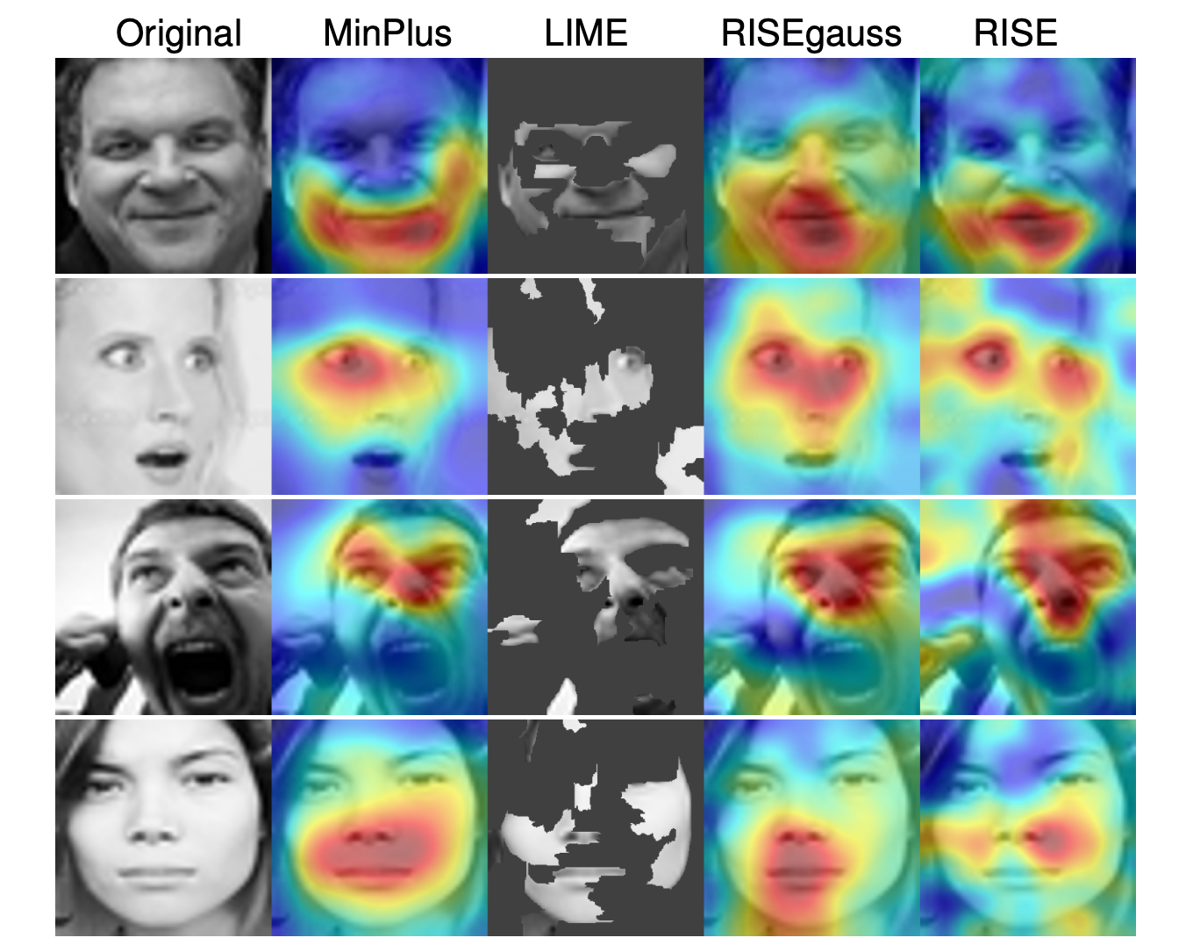
HAPPINESS
Saliency Maps for recognition of expressions using Xception
SURPREISE
ANGRY
NEUTRAL

Slide 47
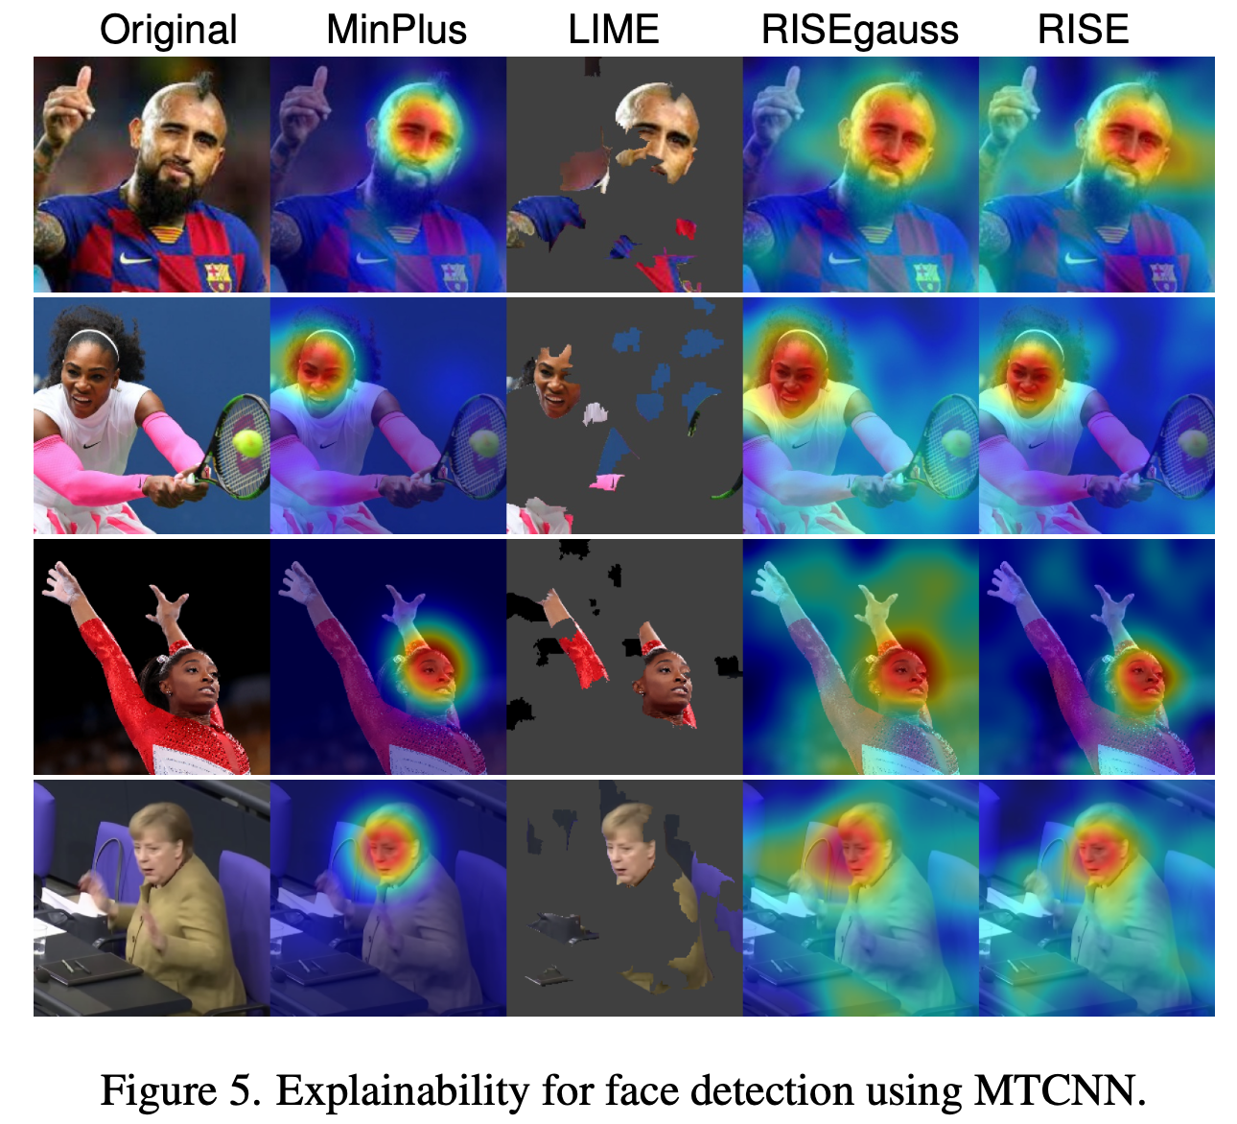
Saliency Maps for face detection using MTCNN

Slide 48
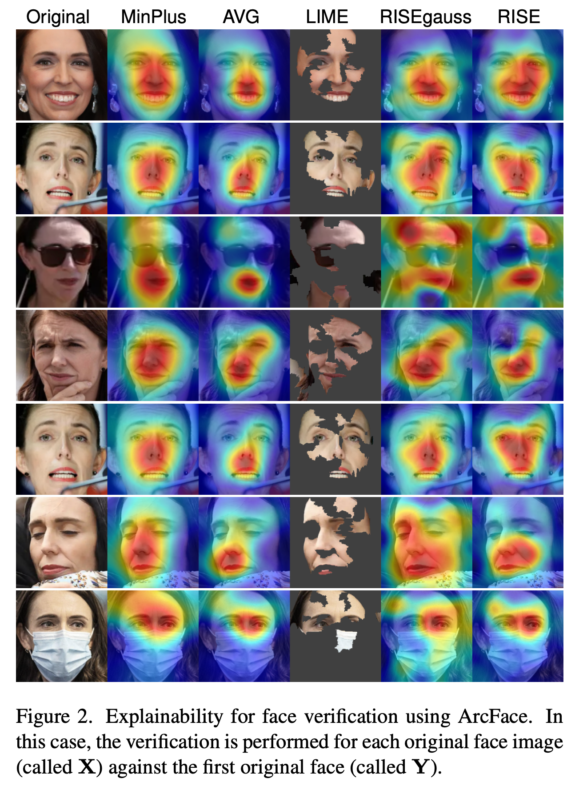
Face Verification
using ArcFace

Slide 49
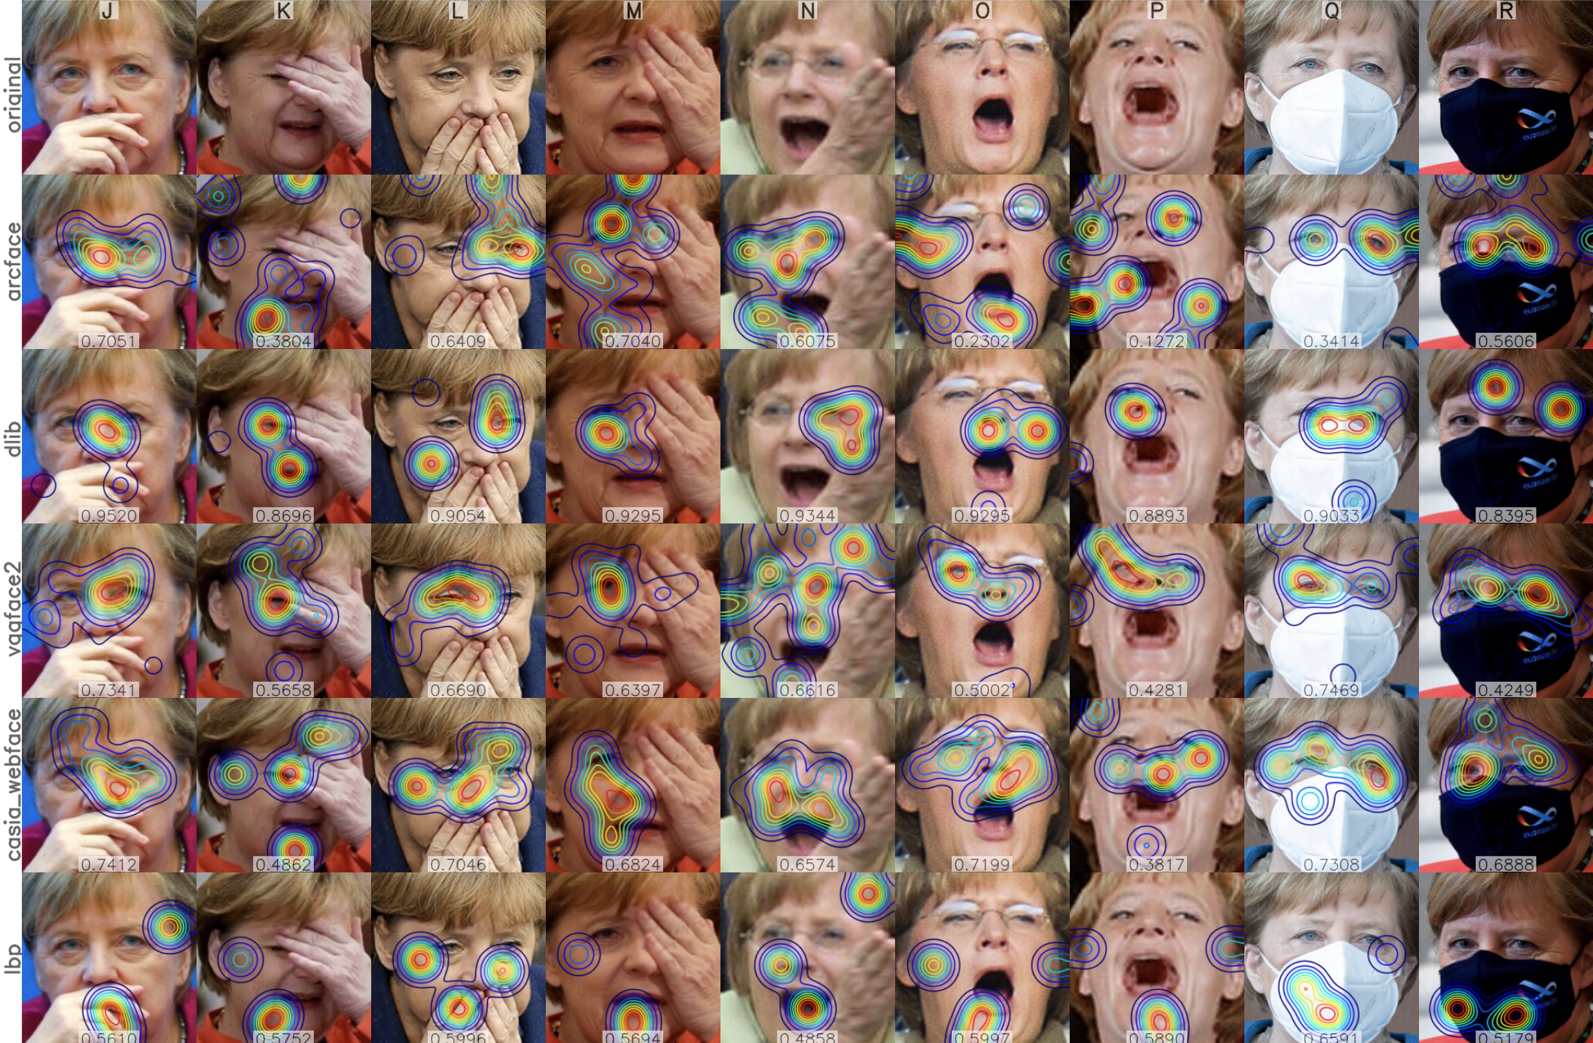
Face Verification:
Real face images with different facial expressions, poses, and occlusions for different matchers

Slide 50
Social Interactions

Slide 51
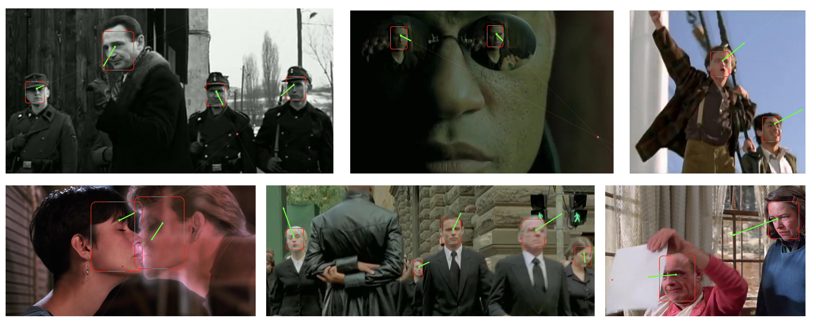
Social Networks: Interactions

Slide 52
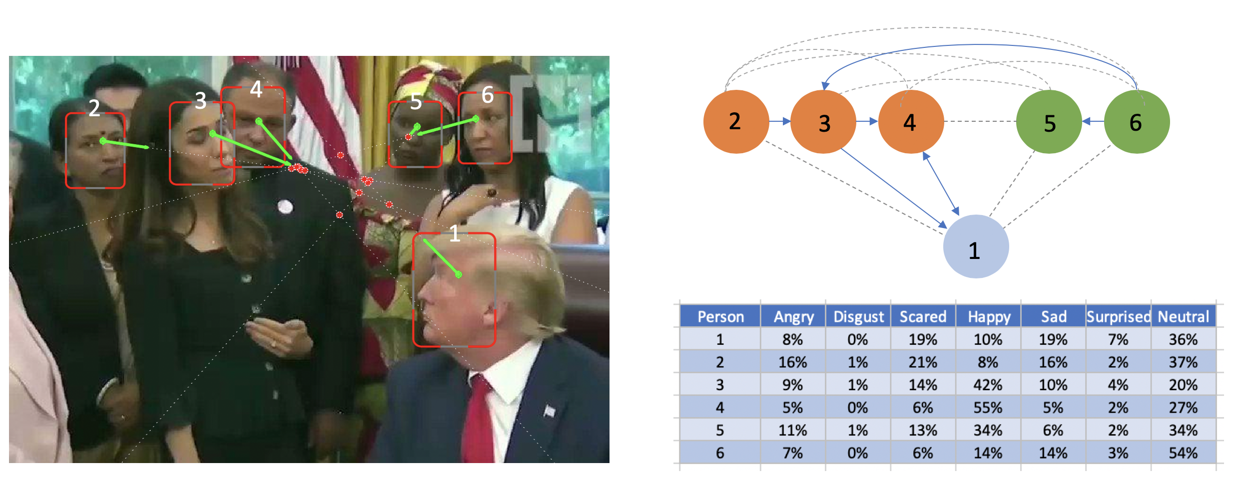
Social Networks: Interactions

Slide 53

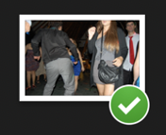
Analysis of
Image
Collections
Wedding
Celebration

Slide 54
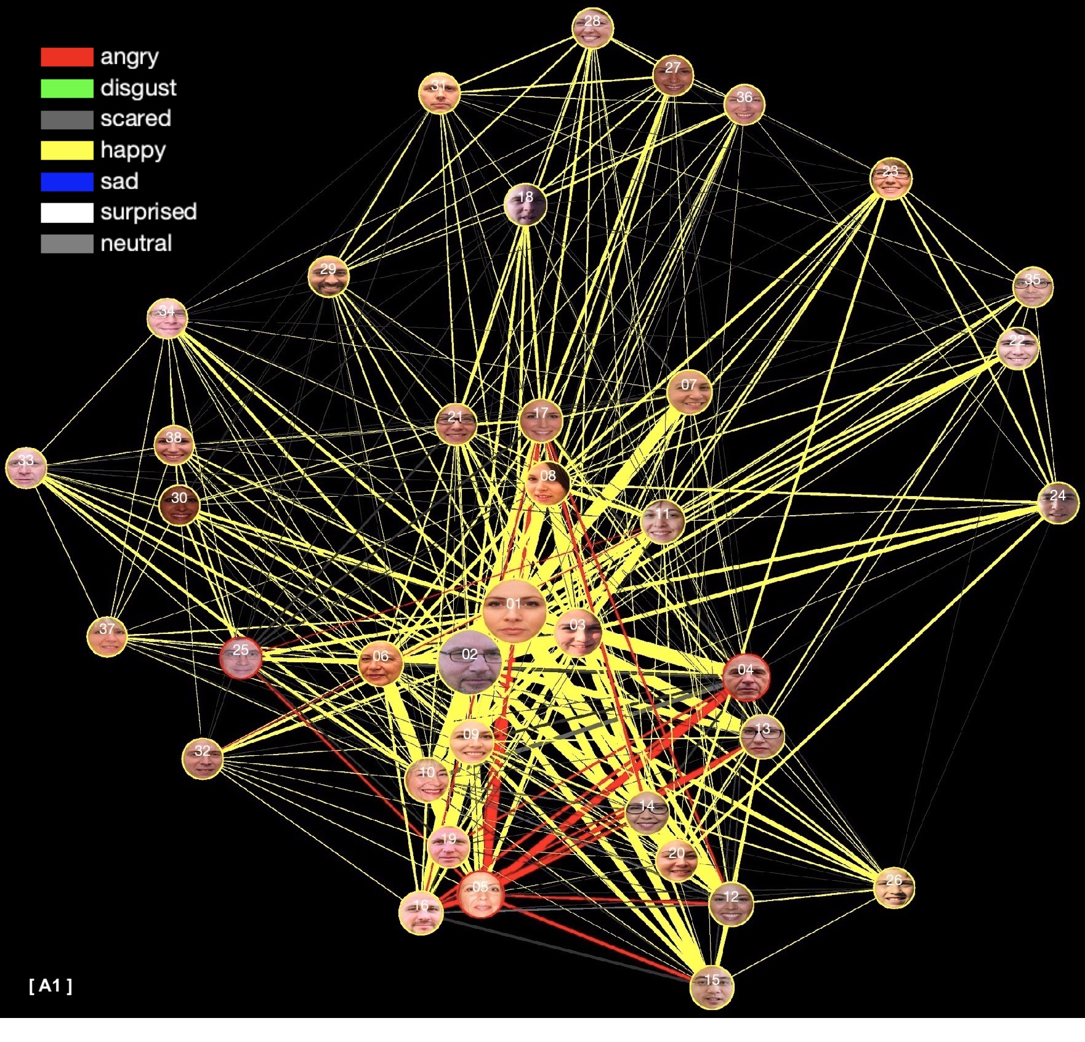
Analysis of
Image
Collections
Wedding
Celebration
Expressions

Slide 55
Aging

Slide 56
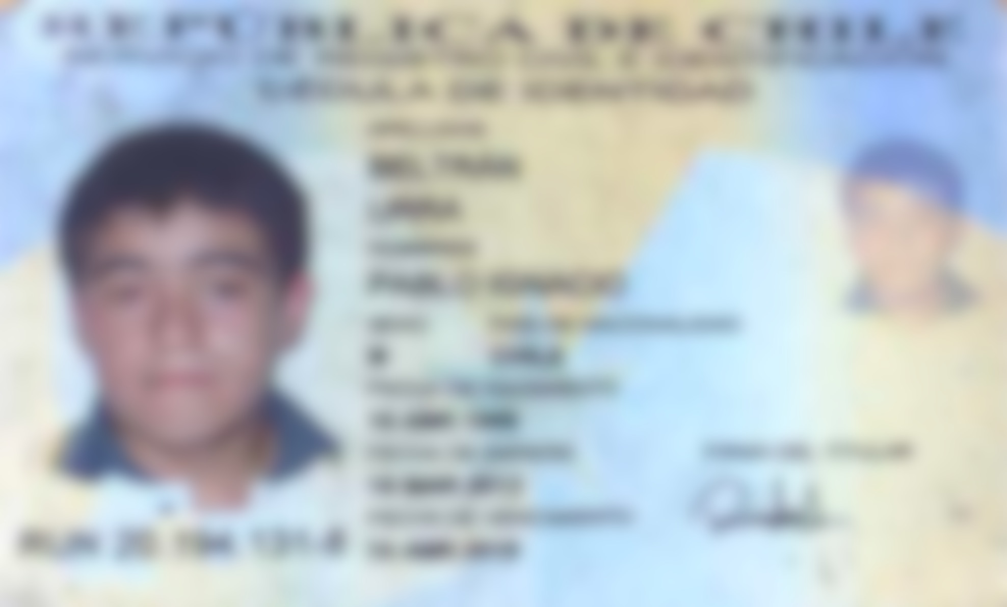

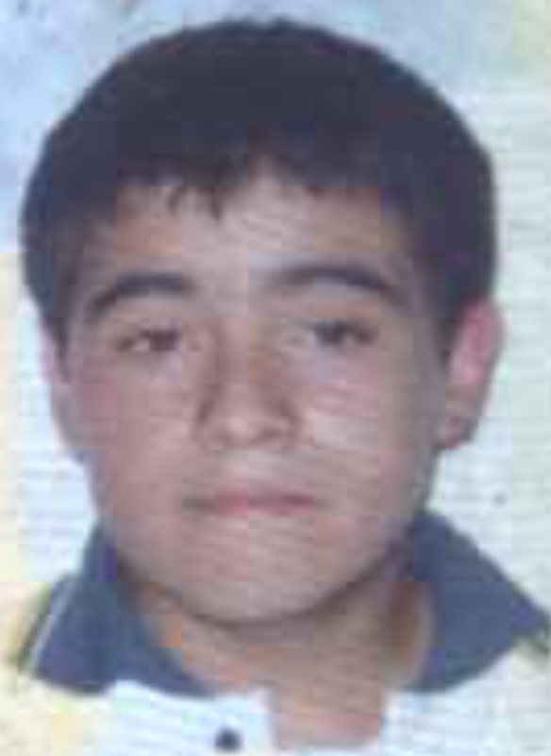
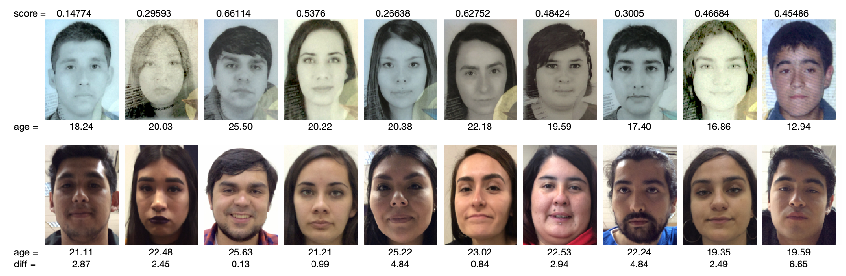
Face verification
across adolescence
ID Photo Selfie
Taken on March, 19th, 2012 Taken on Nov, 12th, 2018
12 years old 19 years old
Is it the same person?

Slide 57


Face Matching: Teenagers to Young Adults
Albiero V, Srinivas N, Villalobos E, Perez-Facuse J, Rosenthal R, Mery D, Ricanek K, Bowyer KW. Identity document to selfie face matching across adolescence. In2020 IEEE International Joint Conference on Biometrics (IJCB) 2020 (pp. 1-9). IEEE.

Slide 58
Face verification
across adolescence
IMAGE 1
IMAGE 2
Albiero V, Srinivas N, Villalobos E, Perez-Facuse J, Rosenthal R, Mery D, Ricanek K, Bowyer KW. Identity document to selfie face matching across adolescence. In2020 IEEE International Joint Conference on Biometrics (IJCB) 2020 (pp. 1-9). IEEE.

Slide 59

Face verification
across adolescence
Age of Image 1 = 18 years old
IMAGE 1
IMAGE 2
Age of Image 2 →
10 12 14 16 18 years
Albiero V, Srinivas N, Villalobos E, Perez-Facuse J, Rosenthal R, Mery D, Ricanek K, Bowyer KW. Identity document to selfie face matching across adolescence. In2020 IEEE International Joint Conference on Biometrics (IJCB) 2020 (pp. 1-9). IEEE.

Slide 60
Face verification
across adolescence
Age of Image 1 = 18 years old
IMAGE 1
IMAGE 2
Age of Image 2 →
10 12 14 16 18 years
Albiero V, Srinivas N, Villalobos E, Perez-Facuse J, Rosenthal R, Mery D, Ricanek K, Bowyer KW. Identity document to selfie face matching across adolescence. In2020 IEEE International Joint Conference on Biometrics (IJCB) 2020 (pp. 1-9). IEEE.

Slide 61
Model Improvements

Slide 62
Model Improvement: I) Human + Computer Vision?

Slide 63

Is it the same person?

Slide 64

Is it the same person? – Eye Tracking

Slide 65



Human + Computer Vision – Example in Face Recognition
Face Recognition in Challenging Images
Is it the same person?
Where do you see when recognizing a face?
Can we include this attention map in our model?

Slide 66
Model Improvement: 2) What about Transformers?

Slide 67

Visual Transformer (ViT)
Zhong, Y., & Deng, W. (2021). Face transformer for recognition. arXiv preprint arXiv:2103.14803.

Slide 68

Visual Transformer (ViT)

Slide 69
Model Improvement: 3) Do we need color images?

Slide 70

Is color relevant in Face Recognition?
Accuracy in Face Recognition using grayscale or color images are very similar.
Bhatta, A., Mery, D., Wu, H., Annan, J., King, M. C., & Bowyer, K. W. (2023). Our Deep CNN Face Matchers Have Developed Achromatopsia. arXiv preprint arXiv:2309.05180.

Slide 71

Is color relevant in Face Recognition?
It is possible to reduce the size of the architecture using only one channel as input (instead of three channels)

Slide 72
Model Improvement: 4) Better GANs?

Slide 73







Problems with GANs for Super-Resolution
LR
56x56
LR
28x28
LR
14x14
ORIGINAL
112x112
HR
112x112
HR
112x112
HR
112x112

Slide 74





GAN for Super-Resolution
Ground truth: real/fake
Real image
Discriminator
HR
real/fake
Generator
error
LR
Fake image
SR
error
Notes:
Zero-sum game theory

Slide 75
GAN for Super-Resolution
Embedding
Ground truth: real/fake
Real image
Discriminator
HR
real/fake
Generator
error
LR
Embedding
Fake image
SR
error
Notes:
Zero-sum game theory

Slide 76
GAN for Super-Resolution
Embedding
Ground truth: real/fake
Real image
Discriminator
HR
real/fake
Generator
error
LR
Embedding
Fake image
SR
error
Notes:
Zero-sum game theory

Slide 77
Ethics

Slide 78

Privacy
versus
Security
The eternal dilemma
Are we giving up privacy for security?
https://www.shponline.co.uk/technology-2/facial-recognition-boom-surveillance-fears-could-be-assuaged-by-built-in-privacy-protection/

Slide 79



Slide 80


Slide 81
Ethics:
Ethics are shared principles that help us distinguish right from wrong.
In Face Recognition, there are possible undesired consequences, for privacy, fairness, etc...
How do we decide what is OK to do? → ETHICS!
We must be ethical when using…
We must be ethical when developing…
We must be ethical when teaching… face recognition

Slide 82
Bonus Track:
ChatGPT ?

Slide 83
What about ChatGPT?
ChatGPT: (...) OpenAI says that it is not ready to roll out facial recognition for public use as it may invite legal issues in jurisdictions that require consent for using biometric data.
BiometricUpdate.com July/2023

Slide 84



What about ChatGPT?
PROPMT (ChatBot Google Bard)
INPUT IMAGE
OUTPUT

Slide 85

What about ChatGPT?
PROPMT (ChatBot Google Bard)

Slide 86

Almost Always
Doing the right thing does not automatically bring success.
But compromising ethics almost always leads to failure
Erika Andersen
* From: Course ‘Data Science Ethics’ by University of Michigan. Prof. H.V. Jagadish

